Slide 1
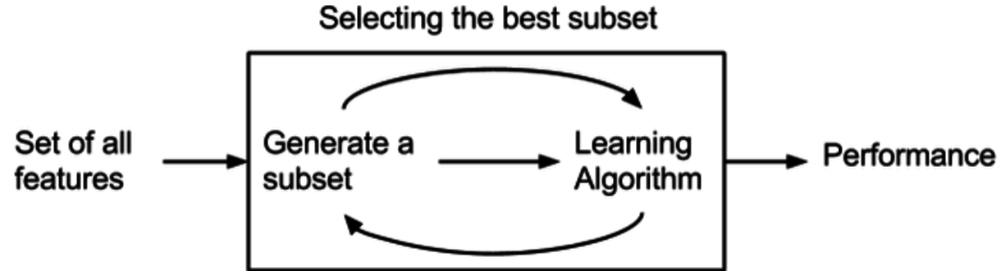
16CSE09 / Machine Learning Techniques
Unit - 3 / Session – 1
CO3: Develop Resampling and Model Selection Methods

Slide 2
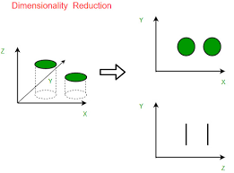
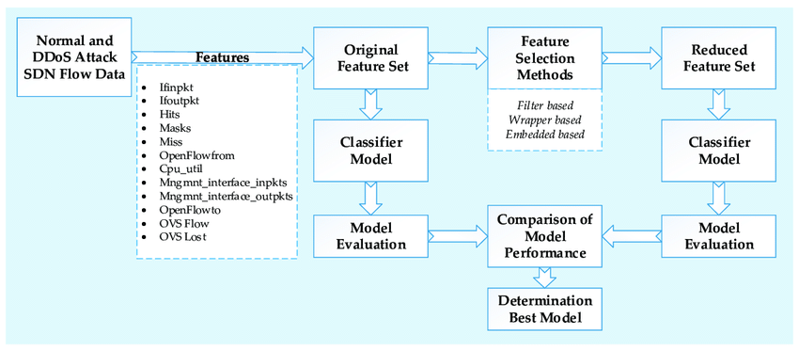
Major Topics:
Resampling
Model Selection
Dimension Reduction Methods

Slide 3
Resampling
When dealing with a Machine Learning task, we need to properly identify the problem so that you can pick the most suitable algorithm which can give you the best score.
In Machine Learning and Data Science we often come across a term called Imbalanced Class Distribution, generally happens when observations in one of the classes are much higher or lower than any other classes.
Machine Learning algorithms tend to increase accuracy by reducing the error, they do not consider the class distribution.
This problem is predominant in examples such as Fraud Detection, Anomaly Detection, Facial recognition etc.

Slide 4
Resampling
Resampling methods are designed to add or remove examples from the training dataset in order to change the class distribution.
Once the class distributions are more balanced, the suite of standard machine learning classification algorithms can be fit successfully on the transformed datasets.
Oversampling methods duplicate or create new synthetic examples in the minority class, whereas undersampling methods delete or merge examples in the majority class.

Slide 5
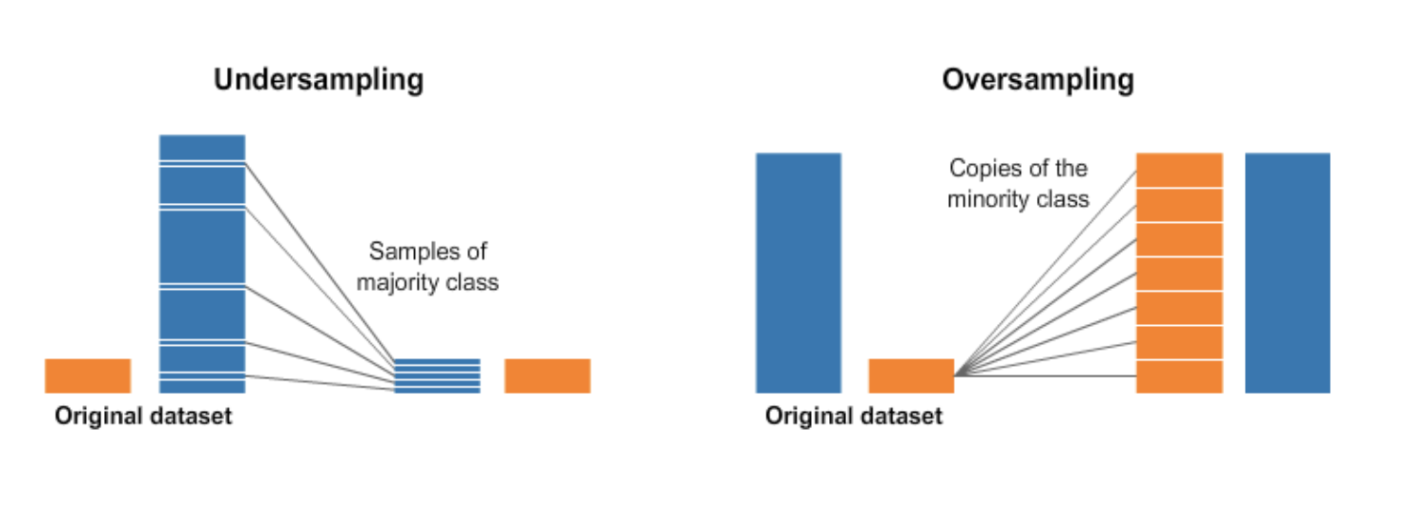
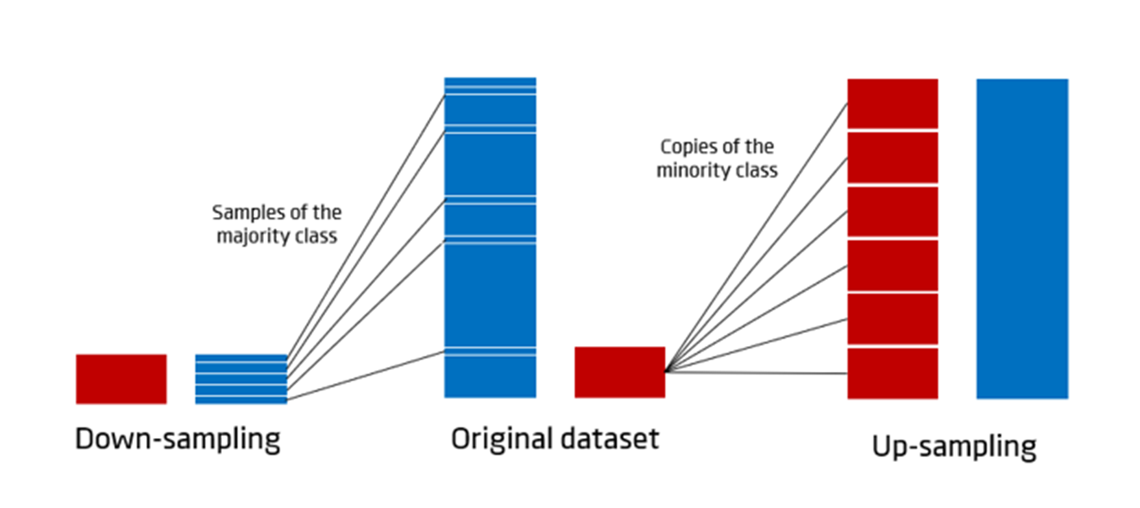
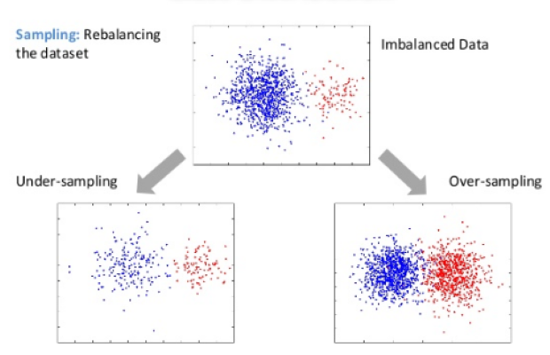
Resampling

Slide 6
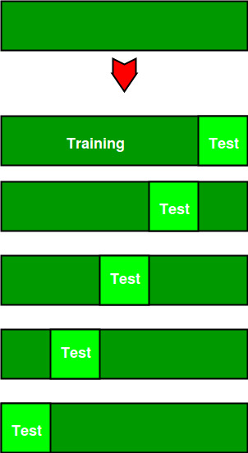
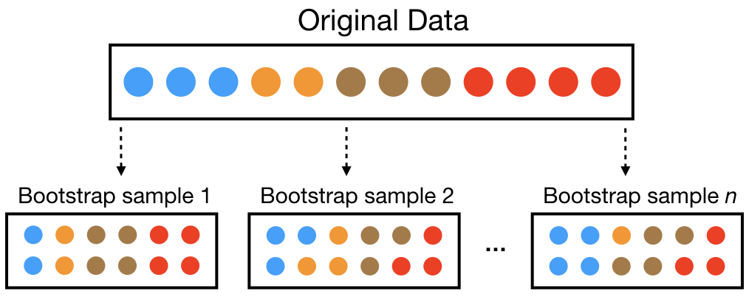
Resampling
Two common methods of Resampling are:
Cross Validation
Bootstrapping

Slide 7
Resampling: Cross Validation
Cross validation is a statistical method used to estimate the performance (or accuracy) of machine learning models.
Cross-Validation is used to estimate the test error associated with a model to evaluate its performance.
The three steps involved in cross-validation are as follows :
Reserve some portion of sample data-set.
Using the rest of the data-set train the model.
Test the model using the reserve portion of the data-set.

Slide 8
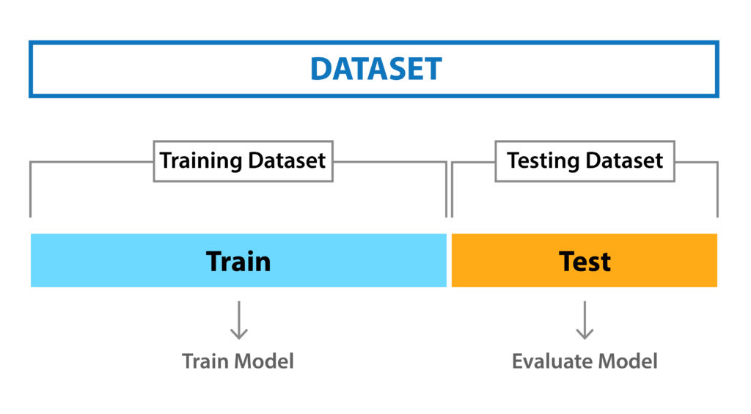
Cross Validation: Validation Set Or Hold-out Approach
This is the most basic approach. It simply involves randomly dividing the dataset into two parts: first a training set and second a validation set or hold-out set. The model is fit on the training set and the fitted model is used to make predictions on the validation set.

Slide 9
Cross Validation: Validation Set Or Hold-out Approach
Basic and simple approach in which we divide our entire dataset into two parts viz- training data and testing data.
we train the model on training data and then evaluate on the testing set.
Usually, the size of training data is set more than twice that of testing data, so the data is split in the ratio of 70:30 or 80:20
In this approach, the data is first shuffled randomly before splitting.
The hold-out method is good to use when you have a very large dataset.

Slide 10
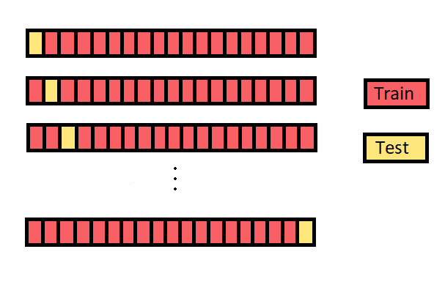
Cross Validation: Leave-one-out-cross-validation
LOOCV is a better option than the validation set approach.
Instead of splitting the entire dataset into two halves only one observation is used for validation and the rest is used to fit the model.

Slide 11
Cross Validation: K fold cross validation
K-fold cross validation is one way to improve the holdout method.
The data set is divided into k number of subsets and the holdout method is repeated k number of times.
Steps:
Randomly split your entire dataset into k number of folds (subsets)
For each fold in your dataset, build your model on k–1 folds of the dataset. Then, test the model to check the effectiveness for k^{th} fold
Repeat this until each of the k-folds has served as the test set
The average of k recorded accuracy is called the cross-validation accuracy and will serve as your performance metric for the model.

Slide 12
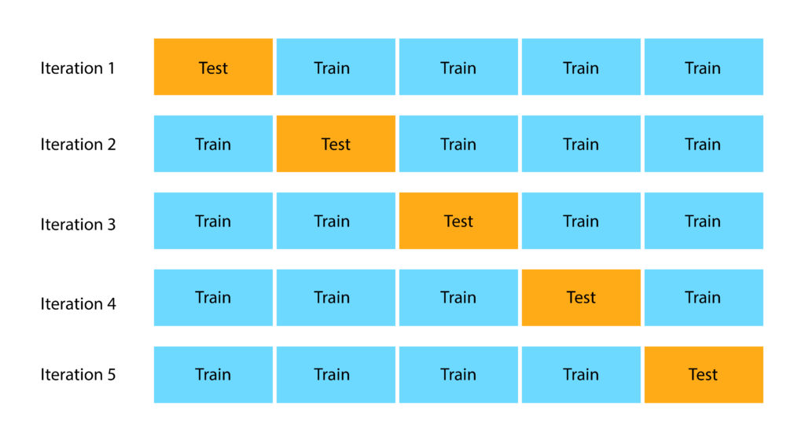
Cross Validation: K fold cross validation

Slide 13
Cross Validation: K fold cross validation
The disadvantage of this method is that the training algorithm has to be rerun from scratch k times, which means it takes k times as much computation to make an evaluation.

Slide 14
K fold Cross Validation: Example
Data sample with 6 observations:
[0.1, 0.2, 0.3, 0.4, 0.5, 0.6]
The first step is to pick a value for k in order to determine the number of folds used to split the data.
Here, we will use a value of k=3. That means we will shuffle the data and then split the data into 3 groups.
Because we have 6 observations, each group will have an equal number of 2 observations.
Fold1: [0.5, 0.2]
Fold2: [0.1, 0.3]
Fold3: [0.4, 0.6]

Slide 15
K fold Cross Validation: Example
Three models are trained and evaluated with each fold given a chance to be the held out test set.
For example:
Model1: Trained on Fold1 + Fold2, Tested on Fold3
Model2: Trained on Fold2 + Fold3, Tested on Fold1
Model3: Trained on Fold1 + Fold3, Tested on Fold2
The models are then discarded after they are evaluated as they have served their purpose.
The skill scores are collected for each model and summarized for use.

Slide 16

Summary
In this session, we have learned about ,
Resampling based on cross validation and
the various types of cross validation

